Slide 1
Unit 4: Section 7 vocabulary you need 2 sheets of lined paper
Vocabulary Diagrams

Slide 2
Do now activity: make 7 diagrams
Picture
Vocabulary diagram
Vocab Word
Teacher Definition
Teacher Sentence
Student Definition
Student Sentence

Slide 3
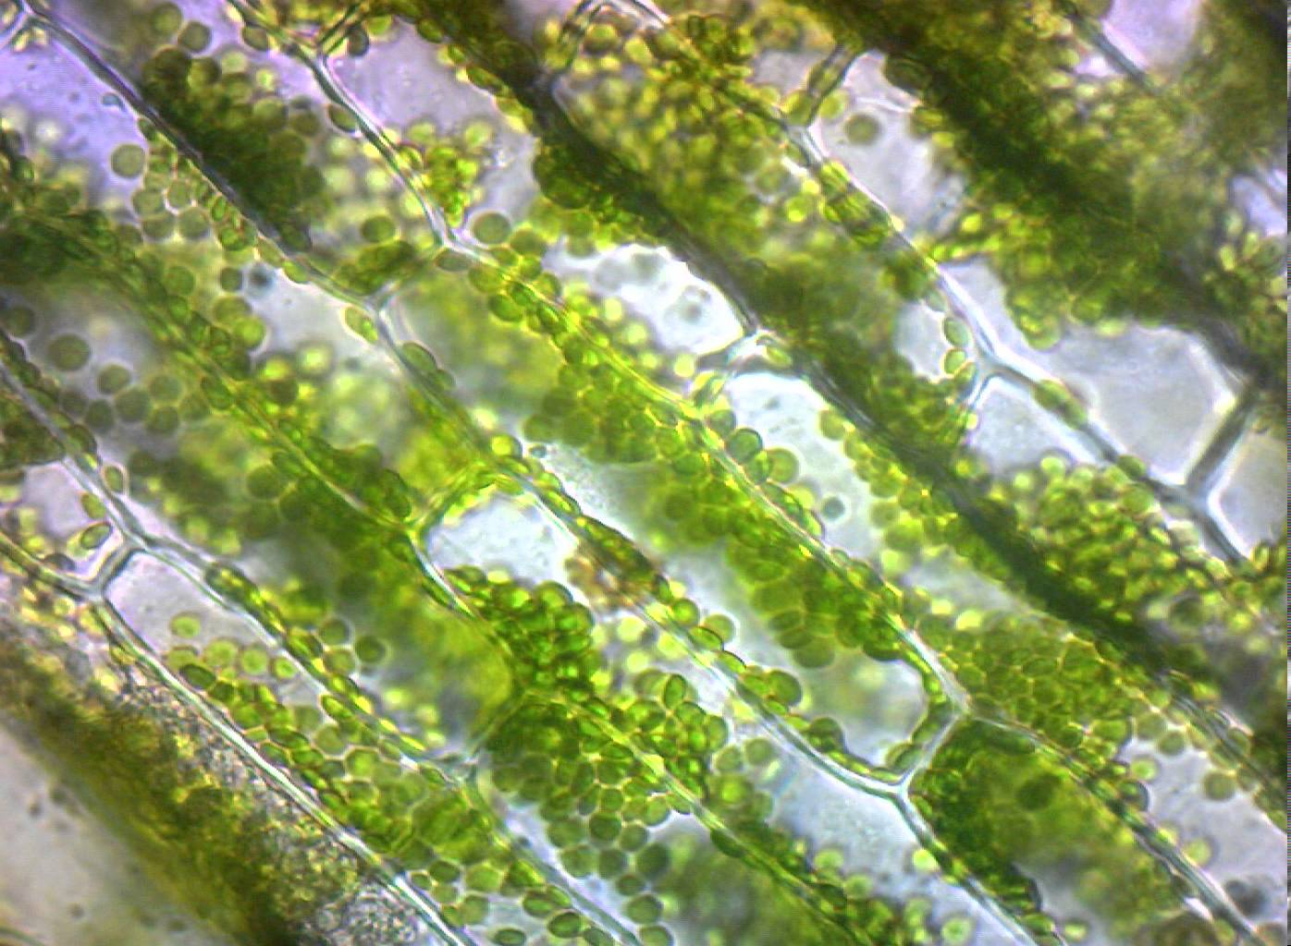
Chloroplast
This is something only plants have because…
The organelle that makes glucose (food) by the process of photosynthesis.
Notes:
Does not change

Slide 4
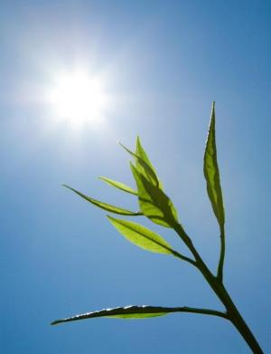
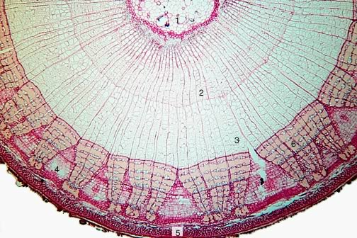
Chloroplast
Not all plant cells have chloroplasts, only the cells that need to
__________ .
Notes:
Does not change

Slide 5
Chloroplast
The organelle that makes glucose (food) by the process of photosynthesis.
Leaves have many chloroplasts in their cells.
Notes:
Water intake, temperature, food intake

Slide 6
Photo-synthesis
Glucose
BIOLOGY

Slide 7
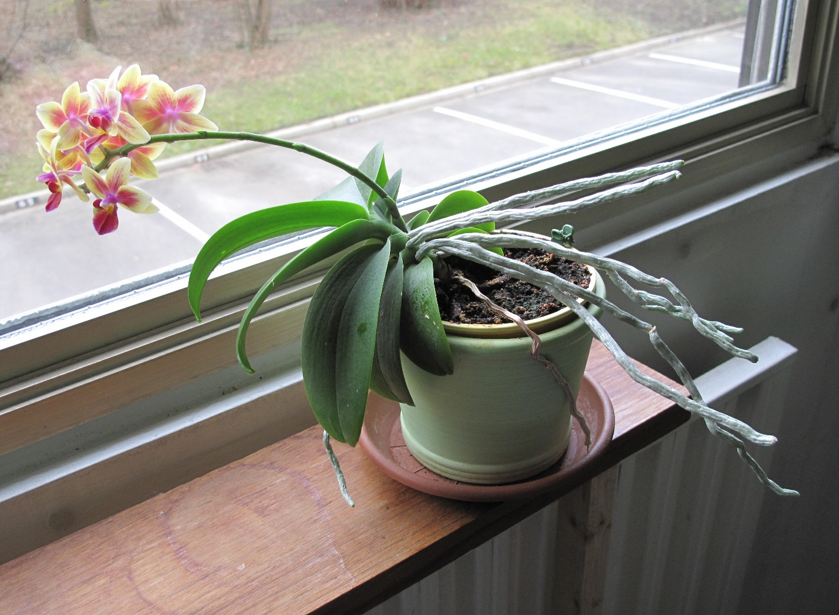
photosynthesis
The process that plants use to make FOOD from sunlight.
When plants use the sun to…
Notes:
Does not change

Slide 8
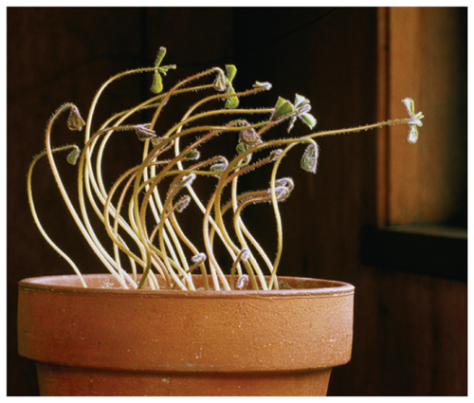
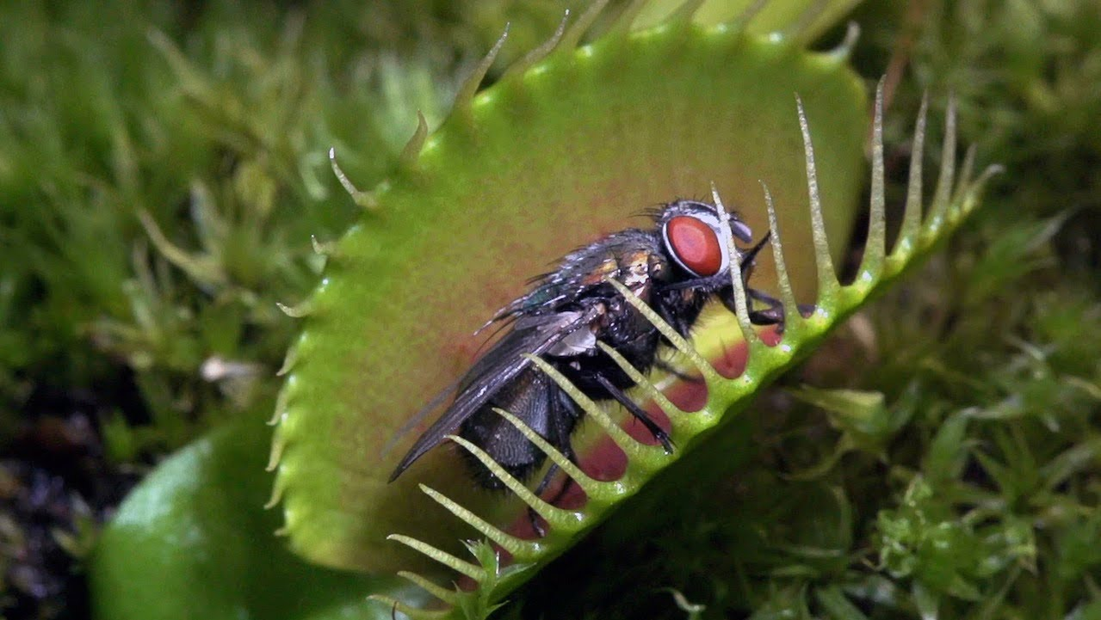
photosynthesis
Plants use photosynthesis to make _____
____________.
Notes:
Does not change

Slide 9
photosynthesis
The process that plants use to make FOOD from sunlight.
Without photosynthesis in plants, animals would not survive.
Notes:
Water intake, temperature, food intake

Slide 10
Glucose
Mito-chondria
BIOLOGY

Slide 11
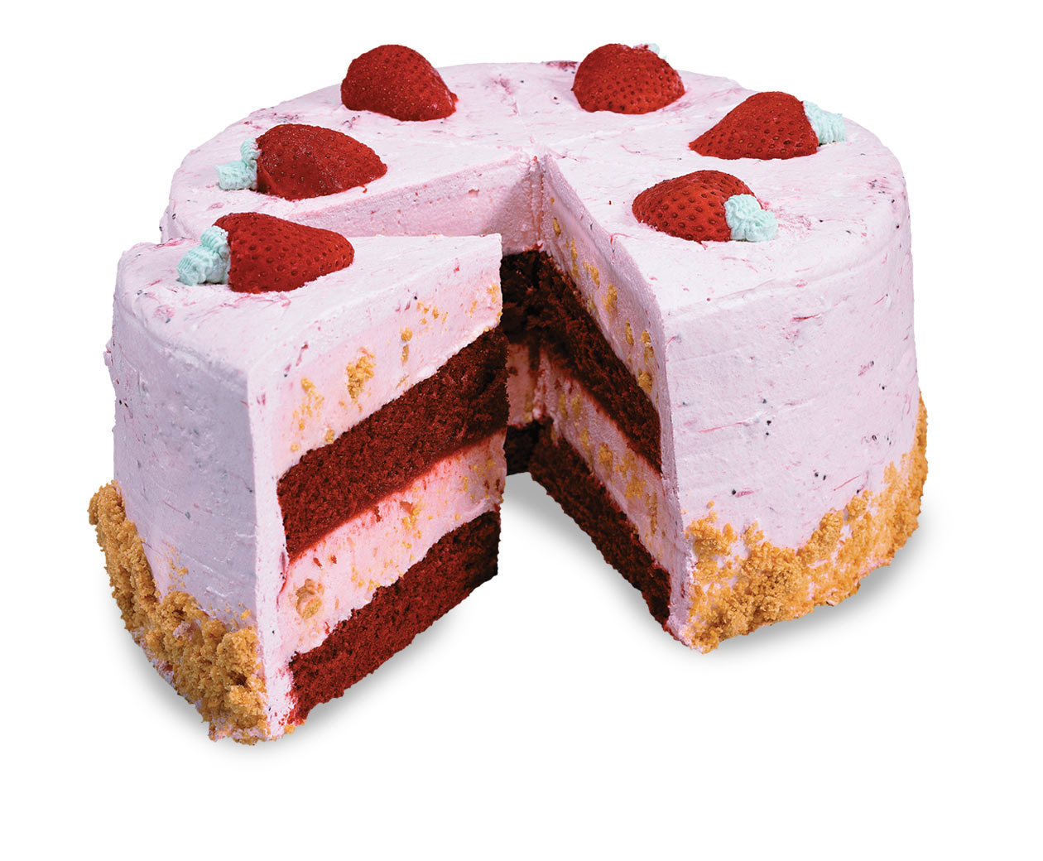
glucose
This is something that plants need because…
The FOOD (sugar) that plants make in photosynthesis.

Slide 12
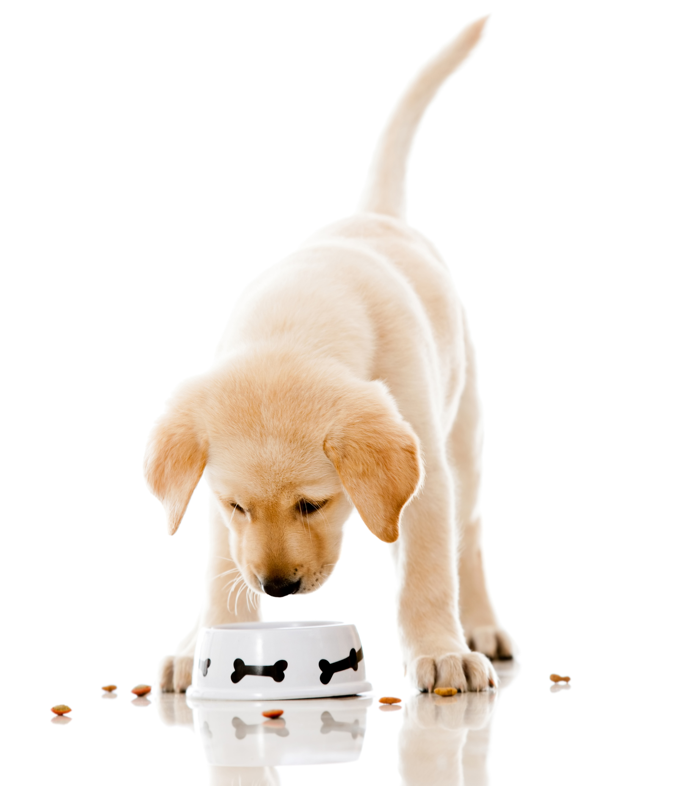
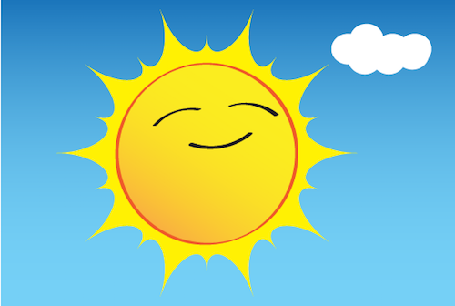
glucose
Instead of _______ , plants make glucose by doing _______ to make food.

Slide 13
glucose
The FOOD (sugar) that plants make in photosynthesis.
Glucose is a macromolecule.

Slide 14
Mito-chondria
ATP
BIOLOGY

Slide 15
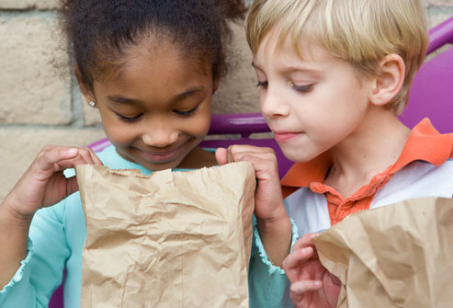
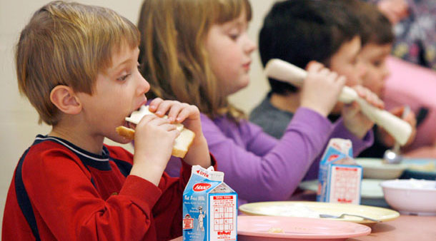
mitochondria
This is responsible for changing…
Converts glucose (food) into ATP.

Slide 16
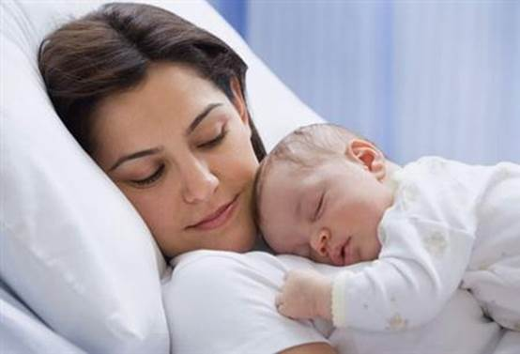
mitochondria
In humans, mitochondria
DNA is passed on to children from the mother; that means it is on the __ chromosome.

Slide 17
mitochondria
Converts glucose (food) into ATP.
Mitochondria is found in both plant and animal cells.

Slide 18
ATP
Energy
BIOLOGY

Slide 19
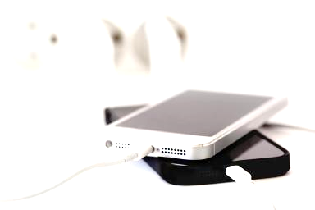
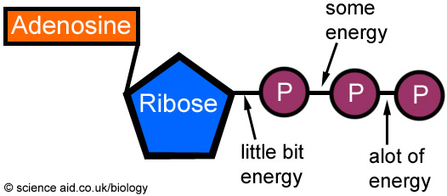
ATP
This does not make energy, this is something our body uses to…
Stores and releases energy.

Slide 20
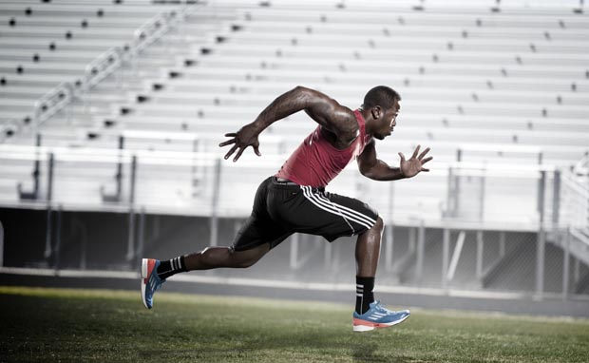
ATP
ATP contains energy so that the body is able to ______
____________
___________ .

Slide 21
ATP
Stores and releases energy.
ATP is made in mitochondria.

Slide 22
Energy
Cellular
Respiration
BIOLOGY

Slide 23
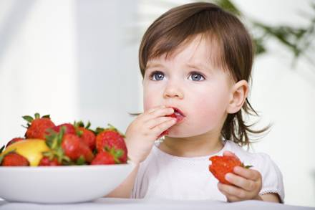
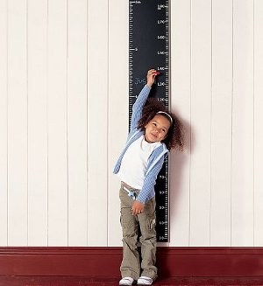
energy
An organism’s body needs it to be able to…
The ability to do work.

Slide 24
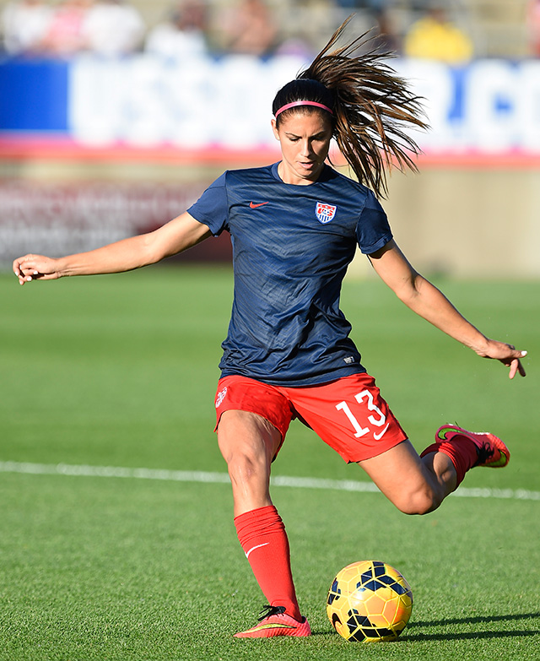
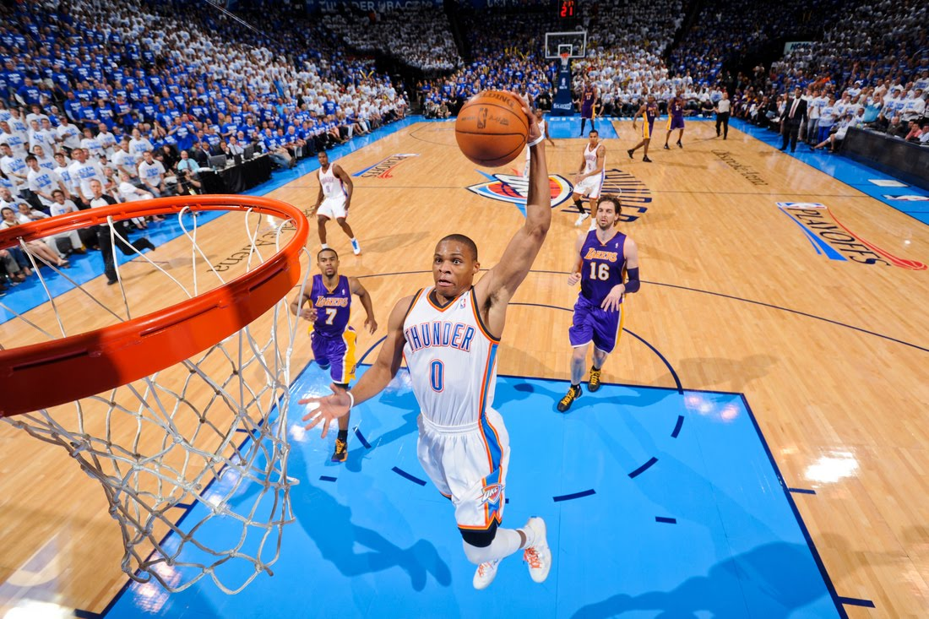
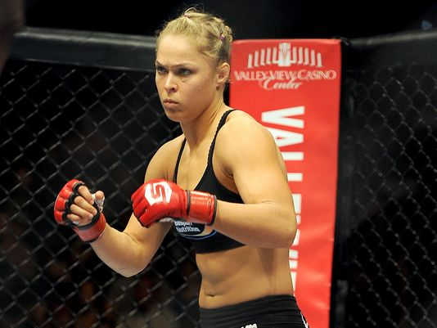
energy
We use energy when we ____
____________
___________ .

Slide 25
energy
The ability to do work.
On Earth, the ultimate source of energy comes from the sun.

Slide 26
Cellular
Respiration
Section 7
Vocab Diagram
Homework
BIOLOGY

Slide 27
Cellular respiration
A process that uses oxygen (O₂) to turn food into energy (ATP).
When food is…

Slide 28
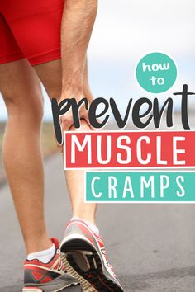
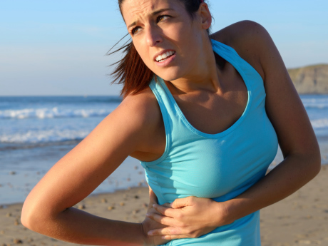
Cellular respiration
Your body uses cellular respiration to make ________ .

Slide 29
Cellular respiration
A process that uses oxygen (O₂) to turn food into energy (ATP).
Cellular respiration happens in the mitochondria.

Slide 30
homework
Finish Vocab Diagrams
For
Unit 4: Section 7

