Slide 1
Section 7-4: Cellular Respiration
Essential Question
Explain the 3 Cellular Respiration Reactions.
(HINT: Where does Glycolysis take place? What does it make & use? Where does Krebs Cycle take place? What does it make & use? Where does ETC take place? What does it make & use?)
Key-terms: glucose, oxygen, Cellular Respiration, mitochondria, glycolysis, krebs cycle, electron transport chain, ATP, aerobic respiration, anaerobic respiration
Learning Target
Use the chemical equation for cellular respiration to explain how energy stored in food molecules provides energy to the cell.

Slide 2
Don’t forget to chunk your notes! These notes have 5 chunks. You will need 5 questions.

Slide 3
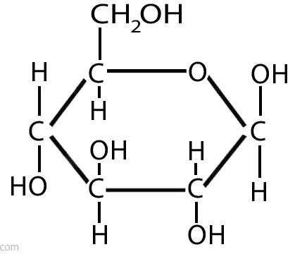
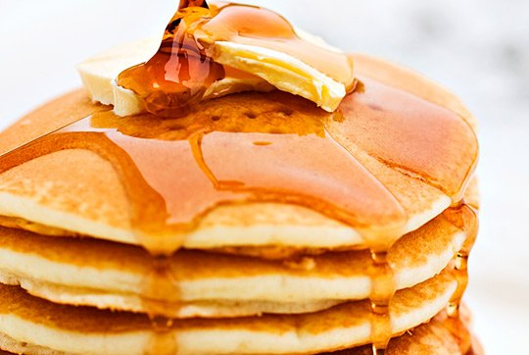
overview
When we eat food, it is broken down into ________ .
glucose
Notes:
glucose

Slide 4
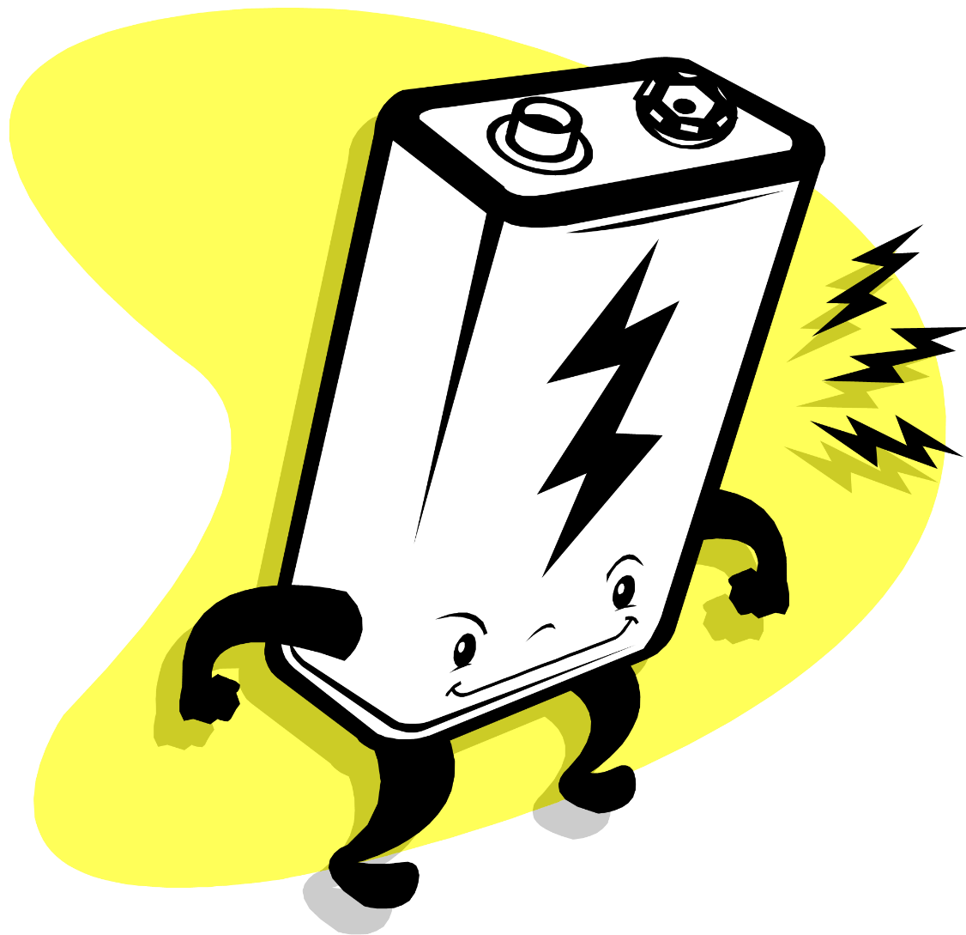
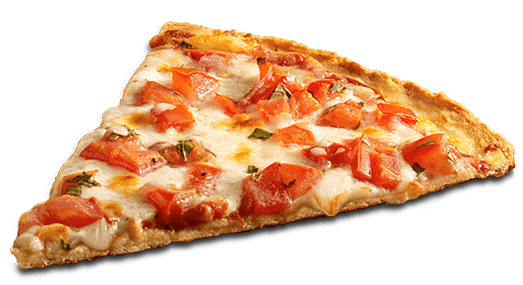
overview
Cellular respiration is a process that turns FOOD (glucose) INTO ENERGY.

Slide 5
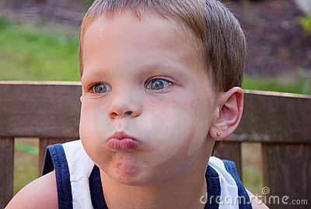
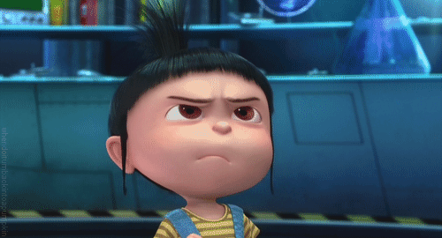
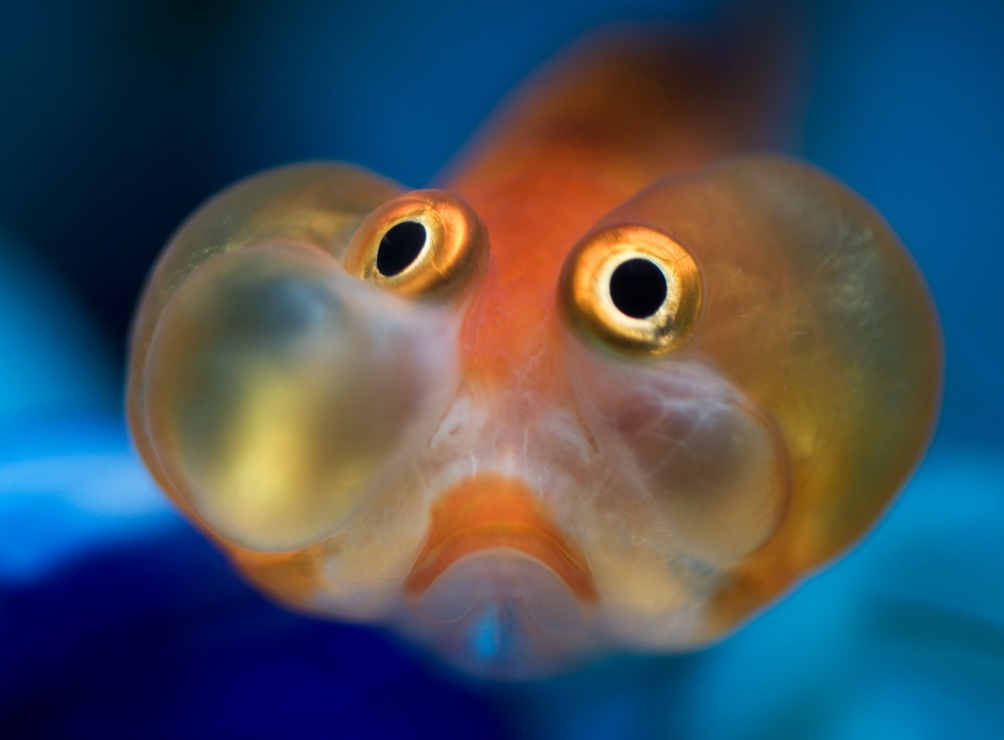
overview
Cellular respiration is aerobic respiration because it needs ____ .
oxygen
Notes:
oxygen

Slide 6
overview
oxygen
We receive _______ when we breathe in.
Notes:
oxygen

Slide 7
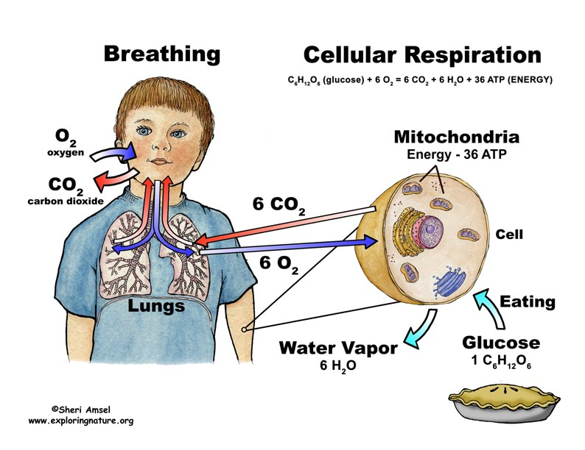
Cellular Respiration Equation
C₆H₁₂O₆ + 6O_{2 →} 6CO₂ + 6H₂O + ATP (energy)
_____ + 6___ → 6___ + 6___ + ATP (energy)
GLUCOSE
OXYGEN
CARBON
DIOXIDE
WATER

Slide 8
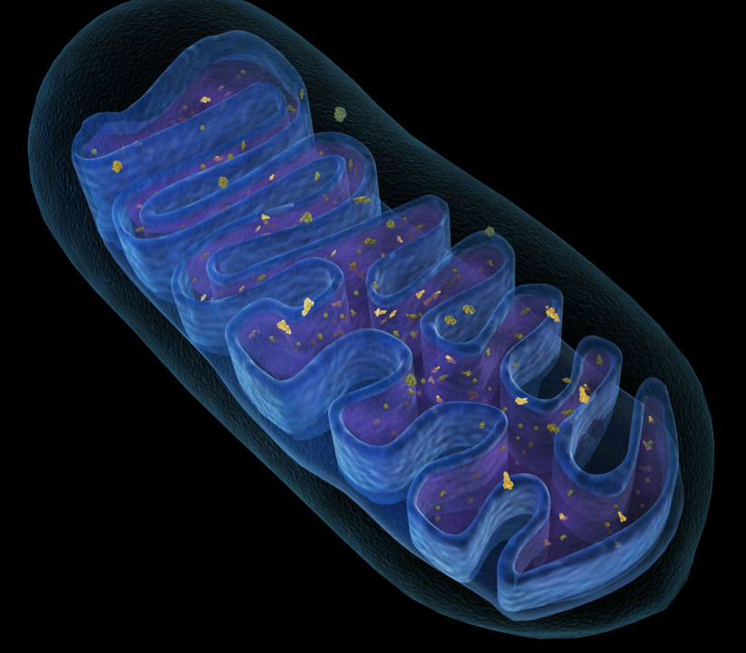
overview
Cellular
Respiration
_____ _______ happens in mitochondria
Notes:
Cellular respiration

Slide 9
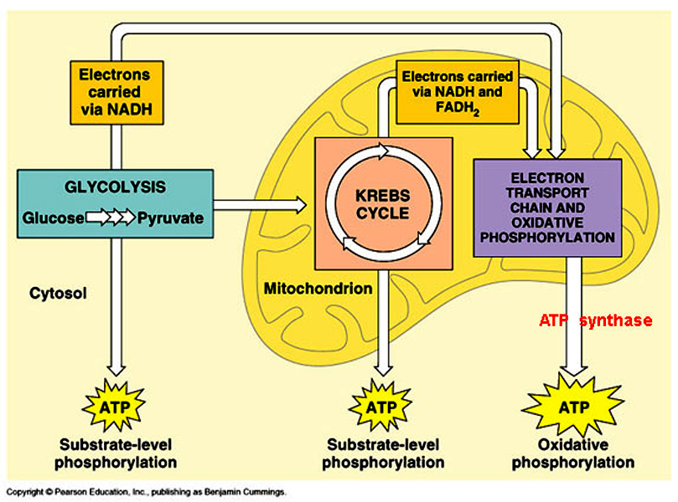
overview
Cellular Respiration has 3 Reactions
Glycolysis
Krebs Cycle
Electron Transport Chain

Slide 10
Don’t forget to chunk your notes! These notes have 5 chunks. You will need 5 questions.

Slide 11
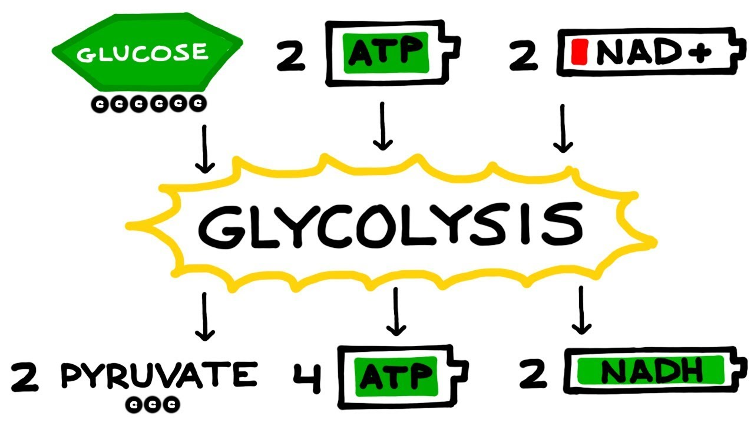
Reaction #1: Glycolysis
Takes place in the CYTOPLASM
Uses:
Makes:
Glucose
2 ATP*
Net 2 ATP*
Pyruvic Acid*
NADH*
(PYRUVATE)

Slide 12
reaction #1: glycolysis
CYTOPLASM
Glycolysis happens in the ______.
cytoplasm
Notes:
glycolysis

Slide 13
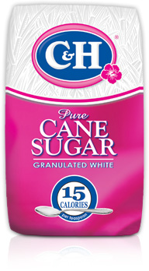
reaction #1: glycolysis
glucose
Glycolysis needs _______ .

Slide 14
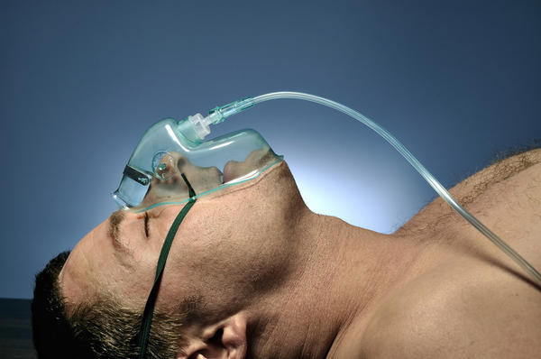
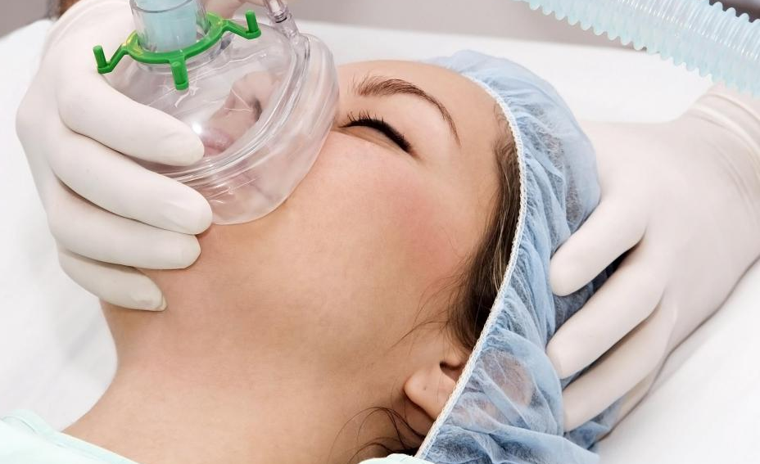
reaction #1: glycolysis
oxygen
Glycolysis does not need ______ .
Notes:
oxygen

Slide 15
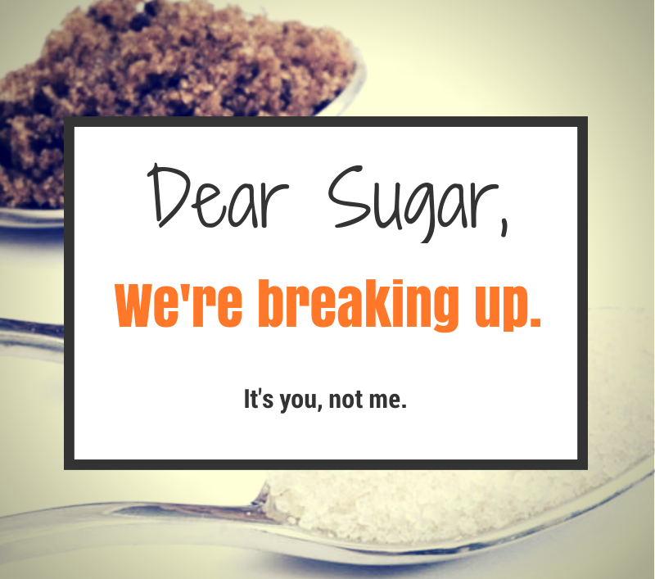
reaction #1: glycolysis
Glycolysis
Glucose + lysis
It means breaking of glucose

Slide 16
How glycolysis works
Step 1
To start the Glycolysis reaction, 2 ATP are used.

Slide 17
How glycolysis works
Step 2
Glucose is broken up and used to make Pyruvic Acid. Pyruvic Acid is sent to the Krebs Cycle.

Slide 18
How glycolysis works
Step 3
The electrons from glucose breaking up causes NAD+ to make NADH. NADH is sent to the ETC.

Slide 19
How glycolysis works
Step 4
In the end, the Glycolysis reaction makes 4 ATP, but you only net gain 2 ATP.

Slide 20
How glycolysis works

Slide 21
Reaction #1: Glycolysis
Takes place in the CYTOPLASM
Uses:
Makes:
Glucose
2 ATP*
Net 2 ATP*
Pyruvic Acid*
NADH*
(PYRUVATE)

Slide 22
After glycolysis
If there is $O_{2}$ (oxygen) available after glycolysis, then cellular respiration continues to the second reaction.
Glycolysis
(NO $O_{2}$)
Krebs Cycle
(NEEDS $O_{2}$)
(CYTOPLASM)
(MITOCHONDRIA)

Slide 23
After glycolysis
If there is not enough $O_{2}$ (oxygen) available, then glycolysis does fermentation over & over again.
Glycolysis
(NO $O_{2}$)
Krebs Cycle
(NEEDS $O_{2}$)
(CYTOPLASM)
(MITOCHONDRIA)

Slide 24
After glycolysis
The difference between anaerobic respiration
VERSUS
aerobic respiration
is…

Slide 25
After glycolysis
…aerobic respiration needs $O_{2}$ (oxygen)…

Slide 26
After glycolysis
…and anaerobic respiration does not need $O_{2}$ (oxygen).

Slide 27
Don’t forget to chunk your notes! These notes have 5 chunks. You will need 5 questions.

Slide 28
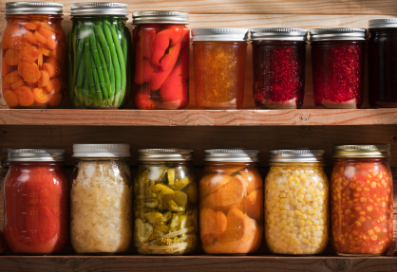
Anaerobic respiration
Anaerobic respiration is fermentation.
Fermentation happens when there no $O_{2}$ (oxygen) available.

Slide 29
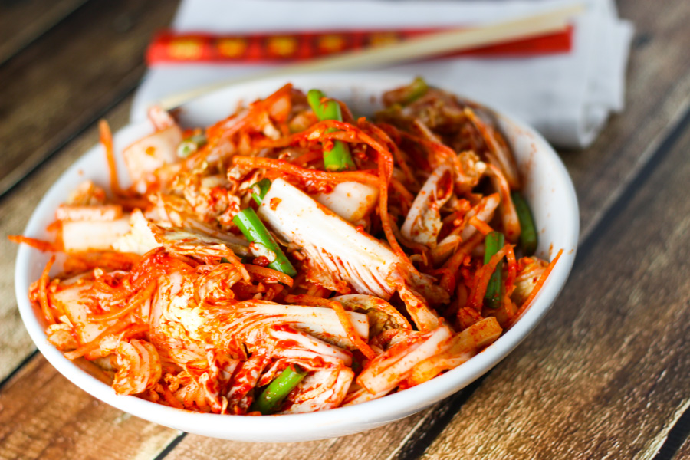
Anaerobic respiration
Fermentation is when energy is made from food, but there is no $O_{2}$ (oxygen).

Slide 30
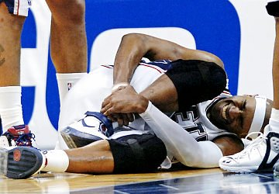
Anaerobic respiration
There are 2 types of fermentation:
1. Alcohol Fermentation
2. Lactic Acid Fermentation

Slide 31
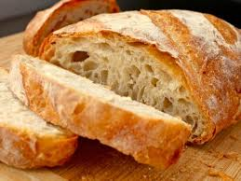
Anaerobic respiration
Alcohol Fermentation
Breaks down pyruvic acid
Makes alcohol and ${CO}_{2}$ gas
Performed by yeast cells
Causes bread dough to rise
${CO}_{2}$ bubbles

Slide 32
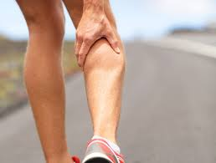
Anaerobic respiration
Lactic Acid Fermentation
Breaks down pyruvic acid
Makes lactic acid
Occurs in muscle cells
Causes muscles to be sore
Lactic acid

Slide 33
Don’t forget to chunk your notes! These notes have 5 chunks. You will need 5 questions.

Slide 34
Reaction #2: KREBS CYCLE
Glycolysis
Krebs Cycle
Electron Transport Chain
(NEEDS $O_{2}$)
(MITOCHONDRIA)
If you have $O_{2}$ (oxygen) after glycolysis, cellular respiration continues to the Krebs Cycle.

Slide 35
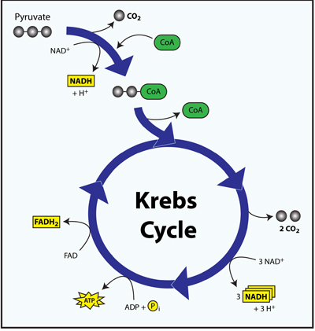
Reaction #2: Krebs cycle
Takes place in the MITOCHONDRIA
Uses:
Makes:
Pyruvic Acid
${CO}_{2}$
2 ATP
NADH*
${FADH}_{2}$*
(PYRUVATE)

Slide 36
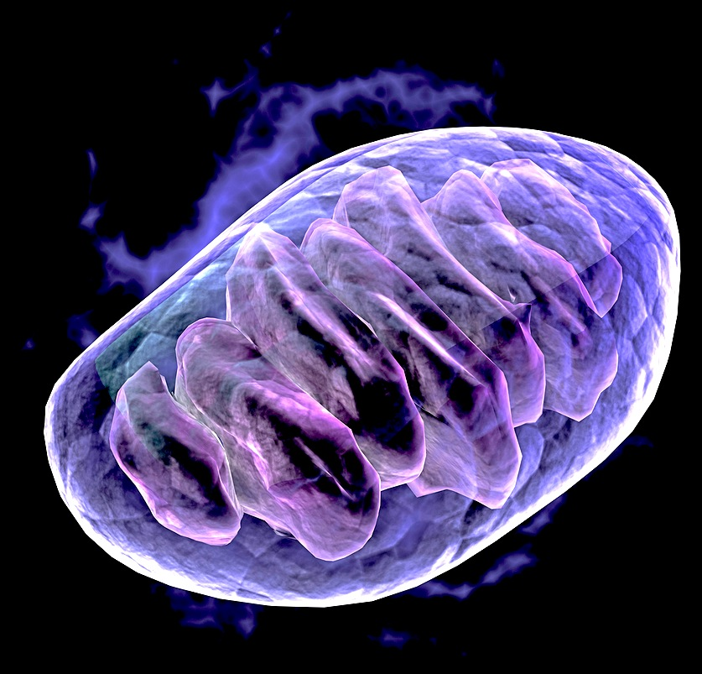
reaction #2: KREBS CYCLE
___ ___ happens in mitochondria.
Krebs Cycle
Notes:
Krebs Cycle

Slide 37
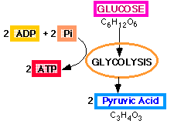
reaction #2: KREBS CYCLE
Pyruvic
Acid
It needs __________ _____ .
Notes:
Pyruvic acid

Slide 38
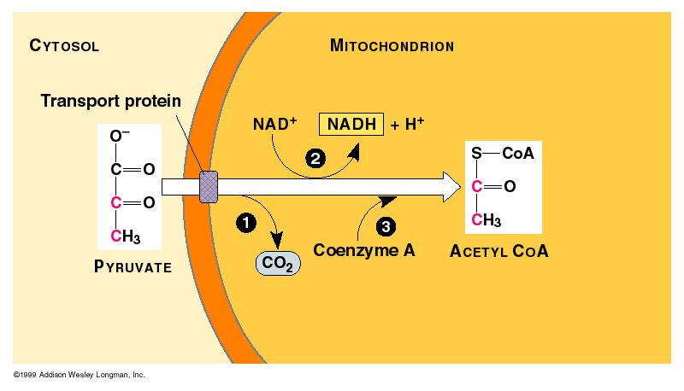
How Krebs cycle WORKS
CYTOPLASM
Step 1
Pyruvic acid travels from the Glycolysis reaction in the cytoplasm to the Krebs Cycle reaction in the mitochondria.
PYRUVIC ACID

Slide 39
How Krebs cycle WORKS
Step 2
Pyruvic acid is broken down to produce ${CO}_{2}$.
PYRUVIC ACID

Slide 40
How Krebs cycle WORKS
Step 3
ATP is produced from ADP + P.

Slide 41
How Krebs cycle WORKS
Step 4
NADH is produced from NAD+. Then, NADH is sent to the ETC.

Slide 42
How Krebs cycle WORKS
Step 5
${FADH}_{2}$ is produced from FAD. Then, ${FADH}_{2}$ is sent to the ETC.

Slide 43
Reaction #2: Krebs cycle
Takes place in the MITOCHONDRIA
Uses:
Makes:
Pyruvic Acid
${CO}_{2}$
2 ATP
NADH*
${FADH}_{2}$*
(PYRUVATE)

Slide 44
Don’t forget to chunk your notes! These notes have 5 chunks. You will need 5 questions.

Slide 45
Reaction #3: ETC
Glycolysis
Krebs Cycle
Electron Transport Chain
(NEEDS $O_{2}$)
(NEEDS $O_{2}$)
(MITOCHONDRIA)
(MITOCHONDRIA)
After Krebs Cycle, cellular respiration continues to the ETC.

Slide 46
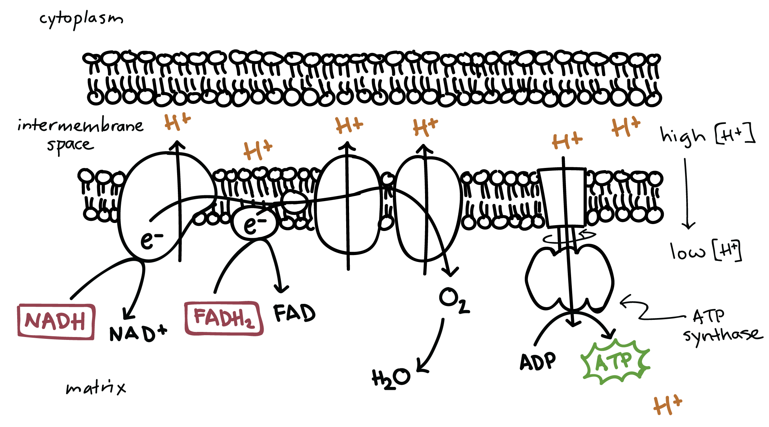
Reaction #3: ETC
Takes place in the MITOCHONDRIA
Uses:
Makes:
NADH*
${FADH}_{2}$*
$O_{2}$
32 ATP
NAD+
FAD
$H_{2}$O
OXYGEN
WATER

Slide 47
Reaction #3: ETC
ETC happens in the mitochondria

Slide 48
Reaction #3: ETC
oxygen
ETC needs _______ .
Notes:
oxygen

Slide 49
Reaction #3: ETC
$${FADH}_{2}$$
ETC receives _____ & _____ from glycolysis and Krebs Cycle.
NADH
Notes:
NADH & FADH2

Slide 50
How ETC works
Step 1
ETC receives high-energy electrons in ${FADH}_{2}$ and NADH from Glycolysis and Krebs Cycle.

Slide 51
How ETC works
Step 2
Uses the electrons to change
ADP + P → ATP
with ATP synthase

Slide 52
How ETC works
Step 3
Now that the electrons are used, ${FADH}_{2}$ changes to ______ .
FAD
Notes:
FAD

Slide 53
How ETC works
Step 4
Now that the electrons are used, NADH changes to ________ .
NAD+
Notes:
NAD+

Slide 54
How ETC works
Step 5
_____ is created from $O_{2}$
$H_{2}$O
Notes:
H2O

Slide 55
Reaction #3: ETC
Takes place in the MITOCHONDRIA
Uses:
Makes:
NADH*
${FADH}_{2}$*
$O_{2}$
32 ATP
NAD+
FAD
$H_{2}$O
OXYGEN
WATER

Slide 56
How ETC works

Slide 57
Don’t forget to chunk your notes! These notes have 5 chunks. You will need 5 questions.

Slide 58
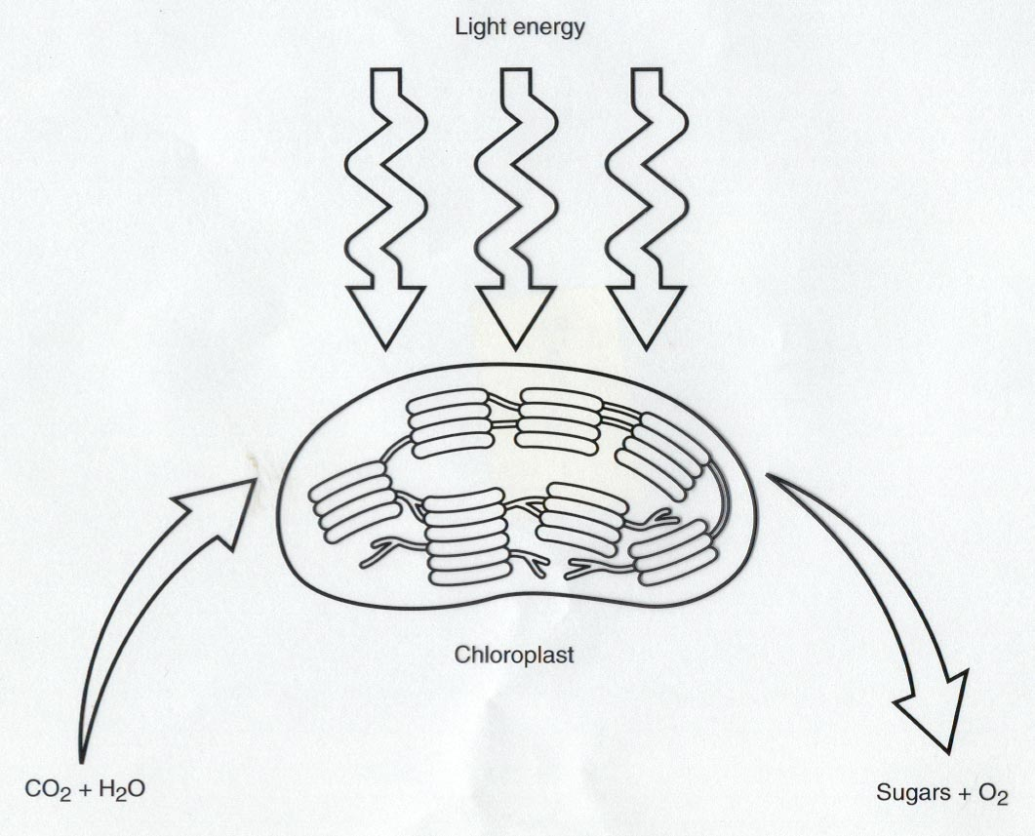
REVIEW
Why do plants need photosynthesis to make glucose?

Slide 59
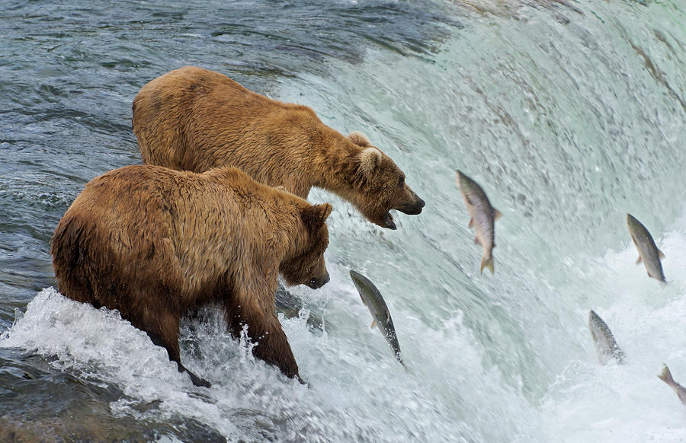
review
Animals are different. How come animals do not need photosynthesis to make glucose?

Slide 60
REVIEW
Why do plants AND animals need to do Cellular Respiration?
Cellular Respiration Equation
C₆H₁₂O₆ + 6O_{2 →} 6CO₂ + 6H₂O + ATP (energy)
_____ + 6___ → 6___ + 6___ + ATP (energy)
GLUCOSE
OXYGEN
CARBON
DIOXIDE
WATER

Slide 61
REVIEW
Electron Transport Chain
Glycolysis
(NEEDS $O_{2}$)
(NEEDS $O_{2}$)
Krebs Cycle
(CYTOPLASM)
(MITOCHONDRIA)
(MITOCHONDRIA)
Why do you need oxygen to be able to do Cellular Respiration?

Slide 62
REVIEW
If there is not enough $O_{2}$ (oxygen) available, then glycolysis does fermentation over & over again.
Glycolysis
(NO $O_{2}$)
Krebs Cycle
(NEEDS $O_{2}$)
(CYTOPLASM)
(MITOCHONDRIA)

Slide 63
review
Total ATP Produced
Reaction | # ATP produced
Glycolysis | Net 2 ATP
Krebs Cycle | 2 ATP
Electron Transport Chain | 32 ATP
Cellular Respiration Total | 36 ATP
Fermentation and Cellular Respiration both make energy. Which reaction is BETTER? WHY?
Notes:
the 36 ATP molecules represents 38% of the energy from glucose
the remaining 62% is released as heat and other molecules

Slide 64
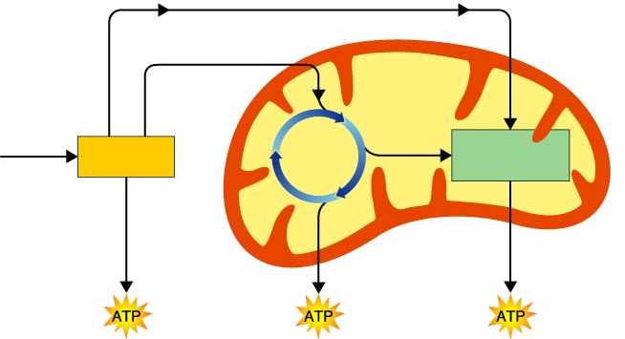
REVIEW
Electrons carried in NADH
Pyruvic acid
Electrons carried in NADH and FADH₂
Glucose
Krebs
Cycle
Electron Transport Chain
Glycolysis
Mitochondrion
Cytoplasm
2 ATP
2 ATP
32 ATP

Slide 65
review
_{sunlight}
6CO₂ + 6H₂O C₆H₁₂O₆ + 6O₂
C₆H₁₂O₆ + 6O₂ 6CO₂+6H₂O+ATP
WHAT IS THE RELATIONSHIP BETWEEN CELLULAR RESPIRATION & PHOTOSYNTHESIS??

Slide 66
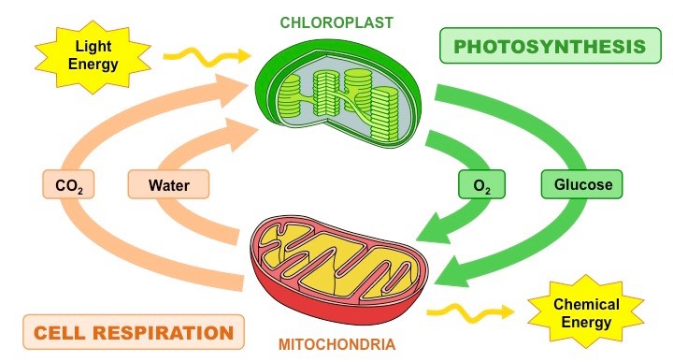
review
WHAT IS THE RELATIONSHIP BETWEEN
CELLULAR RESPIRATION & PHOTOSYNTHESIS?

