Slide 1
Section 7-3: energy
Essential Question
Is energy used or made in photosynthesis? For what purpose? Is energy used or made during cellular respiration? For what purpose?
Key-terms: Photosynthesis, chloroplast, sunlight, water, carbon dioxide, glucose, ATP, Cellular Respiration, food, mitochondria
Learning Target
Use the chemical equation for cellular respiration to explain how energy stored in food molecules provides energy to the cell.

Slide 2
Don’t forget to chunk your notes! These notes have 4 chunks. You will need 4 questions.

Slide 3
energy
SUNLIGHT IS THE MAIN SOURCE OF ENERGY FOR LIFE ON EARTH

Slide 4
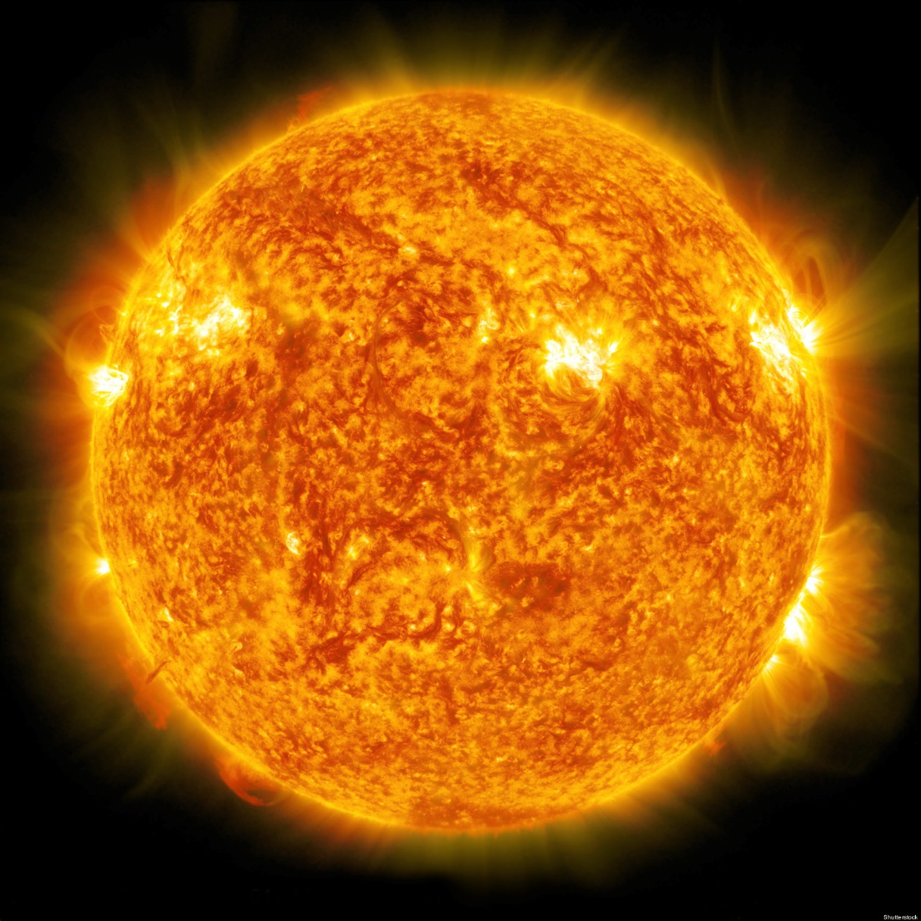
energy
ALL ENERGY comes from the ____ .
sun
Notes:
sun

Slide 5
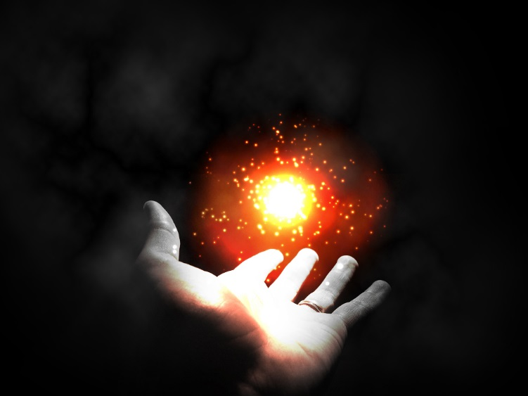
energy
There are 3 types of energy:
Heat
_______
Chemical
Light
Notes:
light

Slide 6
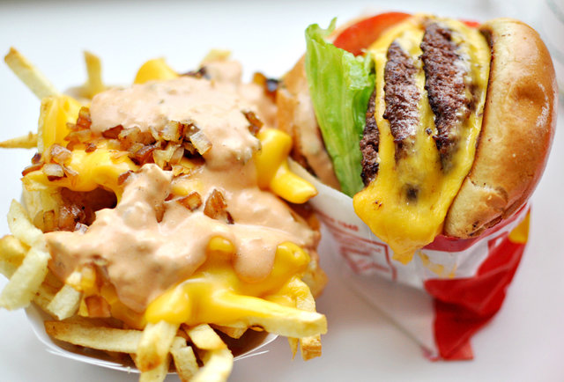
energy
Food stores _________ energy.
chemical
Notes:
chemical

Slide 7
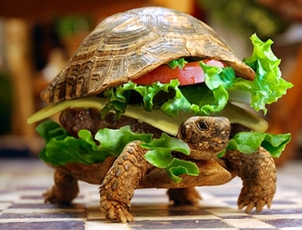
energy
Food is not a usable form of ___________ energy in cells.
It must be converted to a usable form.
chemical

Slide 8
Don’t forget to chunk your notes! These notes have 4 chunks. You will need 4 questions.

Slide 9
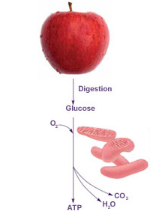
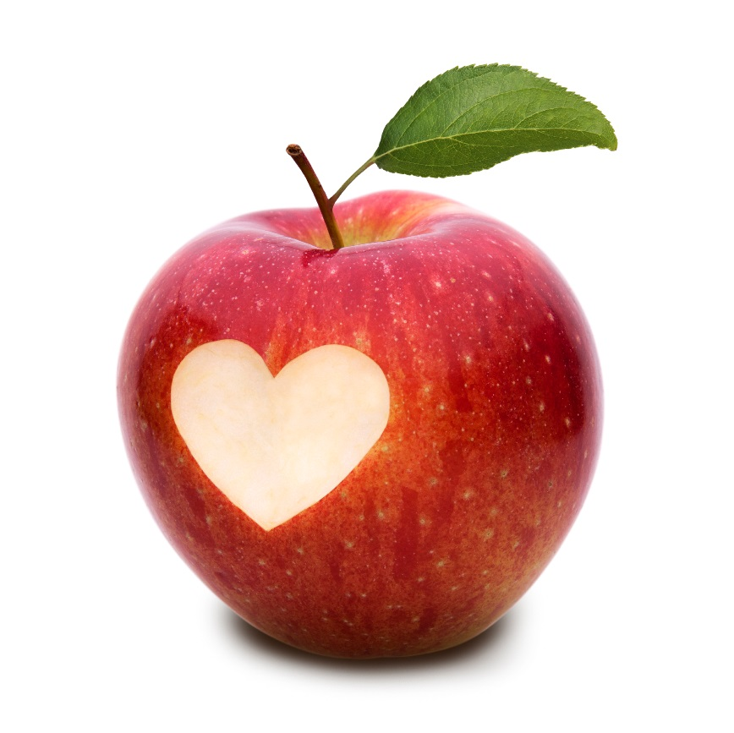
ATP
During CELLULAR RESPIRATION food is changed into: Adenosine TriPhosphate.
(ATP) stores chemical fuel that powers cell’s activities.

Slide 10
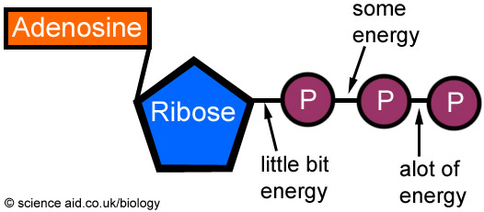
ATP (Adenosine TriPhosphate) has 3 phosphates.

Slide 11
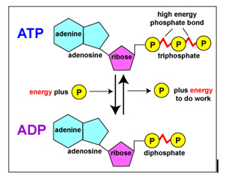
ATP
ADP (Adenosine DiphosPhate) has 2 phosphates instead of 3.

Slide 12
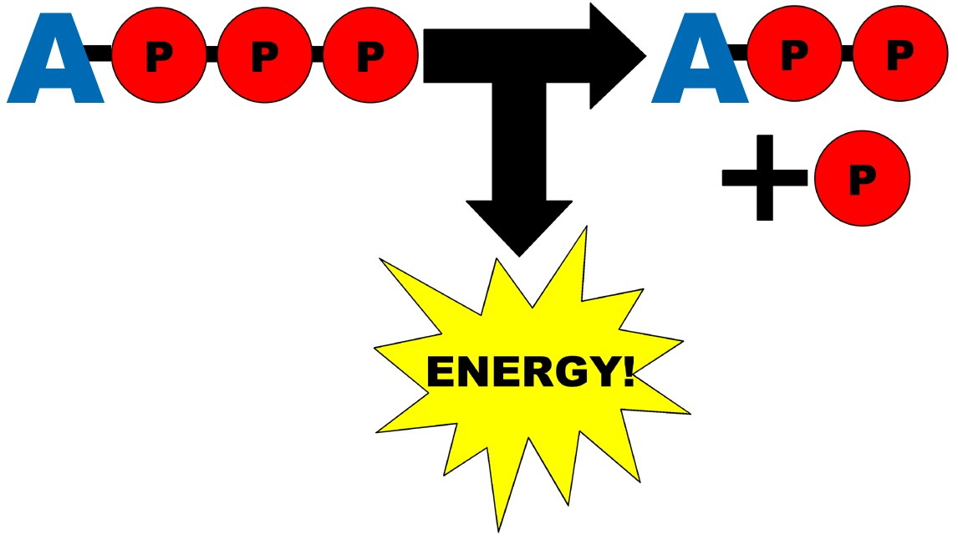
ATP
ATP → ADP + P
Terminal phosphate bond is broken
Energy is released

Slide 13
ATP
ADP + P → ATP
Phosphate added to ADP
Energy is stored

Slide 14
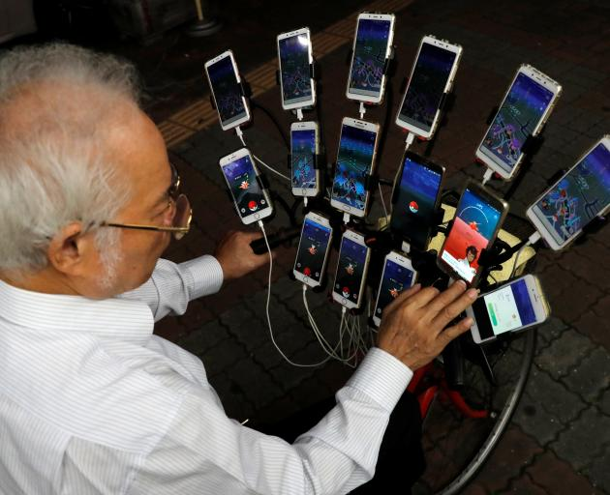
ATP
Cells store small amounts of ATP because it is inefficient for storing energy.

Slide 15
ATP
Energy from carbohydrates (food) are used to make ATP from ADP as needed.

Slide 16
Don’t forget to chunk your notes! These notes have 4 chunks. You will need 4 questions.

Slide 17
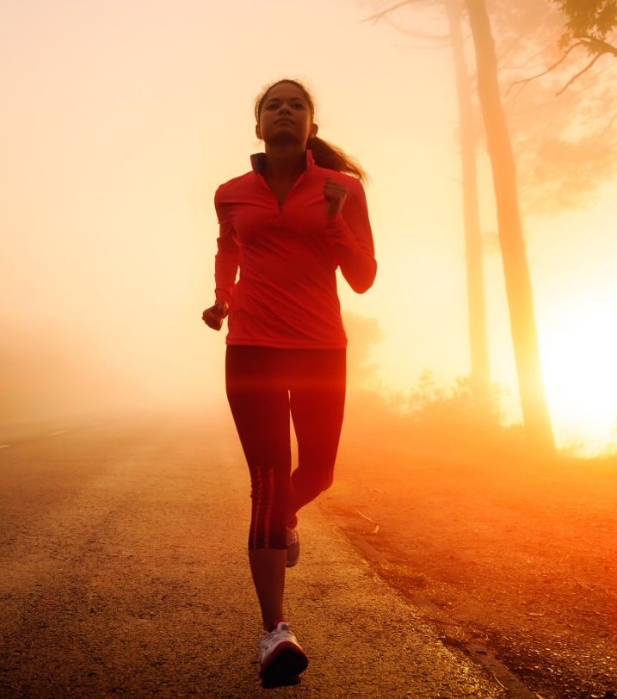
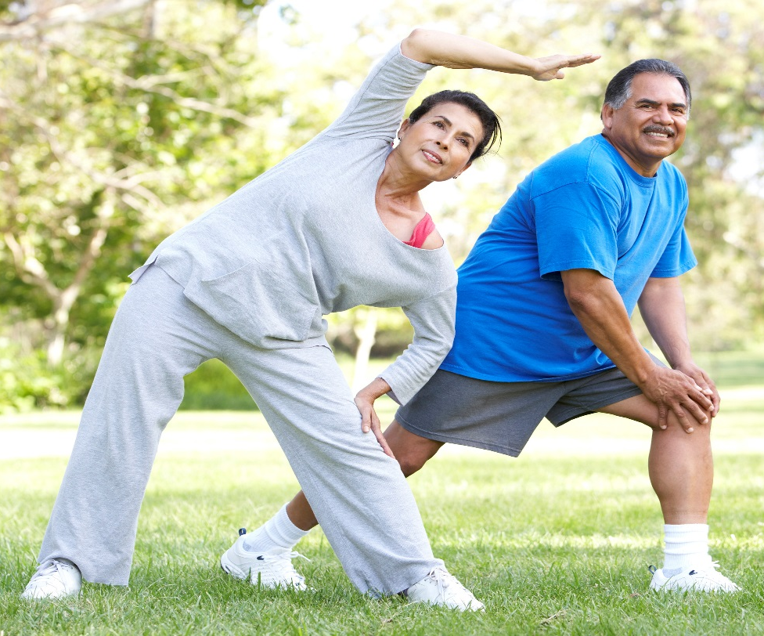
Cellular respiration
When you exercise, ATP stored in muscles is used first.

Slide 18
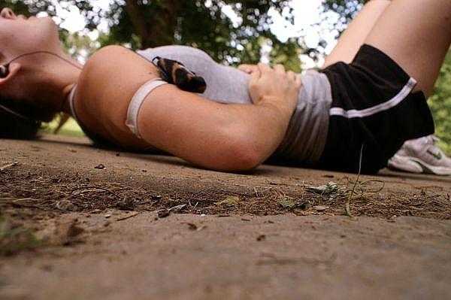
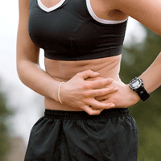
Cellular respiration
LACTIC
ACID
Muscles low on $O_{2}$ begin producing ATP through _______ ___ _____________ . Lactic acid in the body causes muscle cramps.
FERMENTATION
Notes:
Lactic acid fermentation

Slide 19
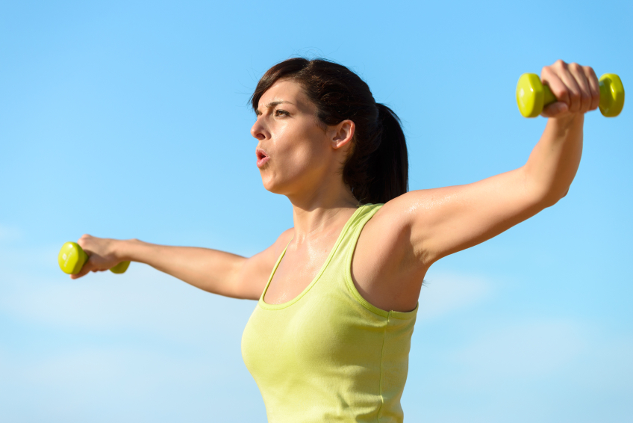
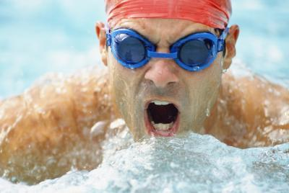
Cellular respiration
Lactic acid is eliminated in the body by heavy breathing (taking in more $O_{2}$).

Slide 20
Cellular respiration
REACTANTS
PRODUCTS
Glucose (C₆H₁₂0₆)
+
Oxygen (0₂)
Glycolysis
Krebs Cycle
Electron Transport Chain
Carbon
Dioxide
(CO₂)
+
Water
(H₂O)
Cellular respiration can produce ATP for exercise lasting about 30 minutes.

Slide 21
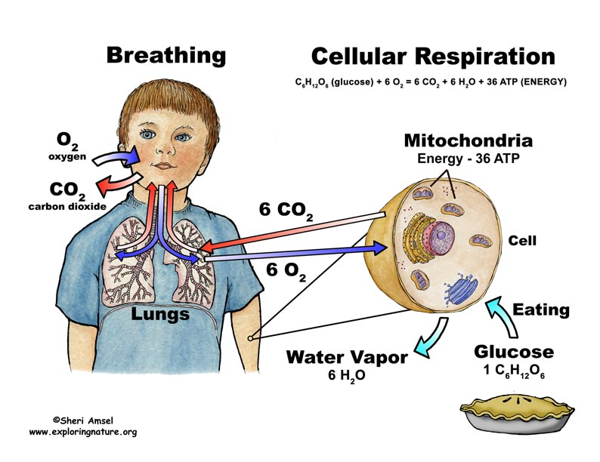
Cellular Respiration Equation
C₆H₁₂O₆ + 6O_{2 →} 6CO₂ + 6H₂O + ATP (energy)

Slide 22
What is cellular respiration’s PURPOSE?
Notes:
To make energy. But it also produces carbon dioxide & water.

Slide 23
Cellular Respiration Equation
C₆H₁₂O₆ + 6O_{2 →} 6CO₂ + 6H₂O + ATP (energy)

Slide 24
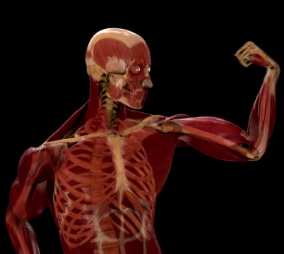
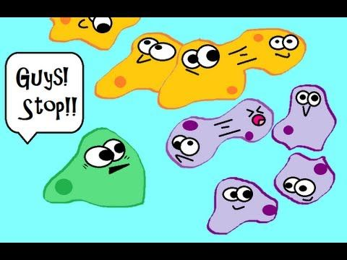
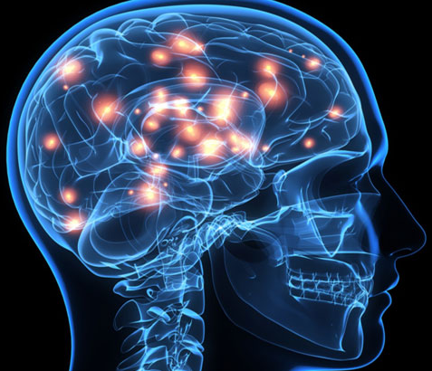
Energy released from
ATP is used to…
Contract muscles
Send messages from the brain to the rest of the body
Cell-to-cell communication

Slide 25
Don’t forget to chunk your notes! These notes have 4 chunks. You will need 4 questions.

Slide 26
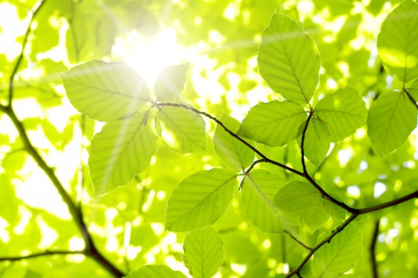
Photosynthesis’ CONNECTION TO CELLULAR RESPIRATION
Plants are autotrophs (producers)
that use photosynthesis to make their own ______ .
food
Notes:
food

Slide 27
Photosynthesis equation
Uses
(Left side of the arrow = REACTANTS)
Light energy
carbon dioxide (CO₂)
water (H₂O)
Makes
(Right side of the arrow = PRODUCTS)
oxygen (O₂)
glucose (C₆H₁₂O₆)

Slide 28
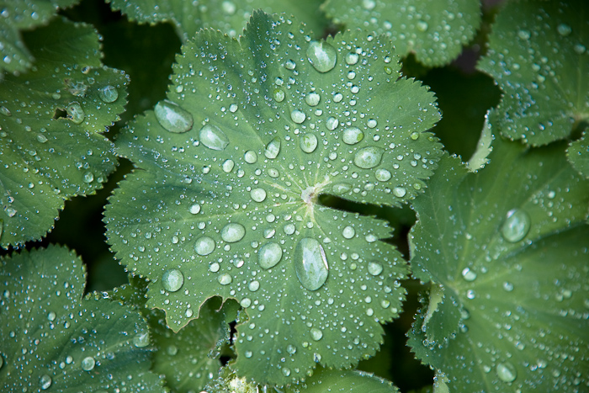
Photosynthesis’ CONNECTION TO CELLULAR RESPIRATION
Plants need ____ & ____ _____
as reactants for photosynthesis.
$$water$$
($H_{2}O$)
$$carbon$$
$$dioxide$$
(${CO}_{2}$)
Notes:
Water & carbon dioxide

Slide 29
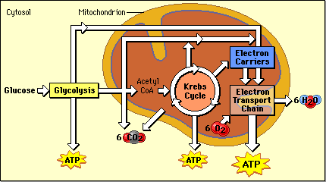
Photosynthesis’ CONNECTION TO CELLULAR RESPIRATION
These reactants come from ___ ______ .
$$Cellular$$
$$Respiration$$
Notes:
Cellular respiration

Slide 30
Cellular Respiration Equation
C₆H₁₂O₆ + 6O_{2 →} 6CO₂ + 6H₂O + ATP (energy)

Slide 31
What is photosynthesis’ PURPOSE?
Notes:
To make glucose (food) for plants. But it also produces oxygen!

Slide 32
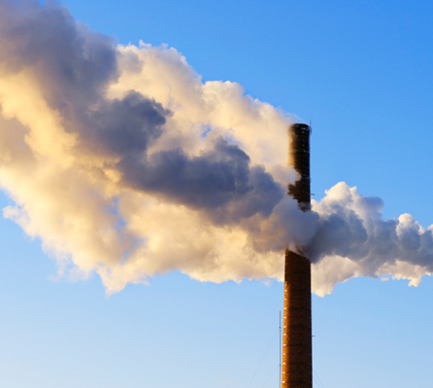
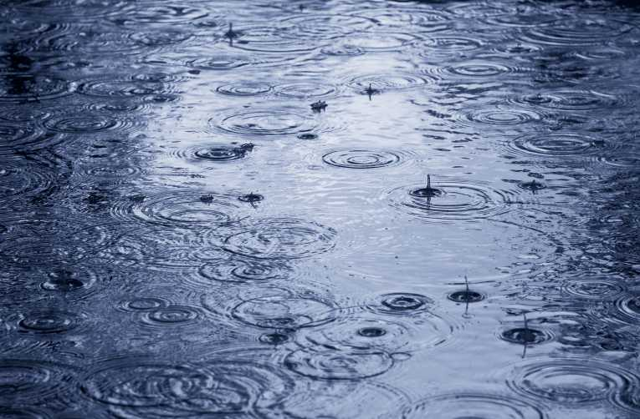
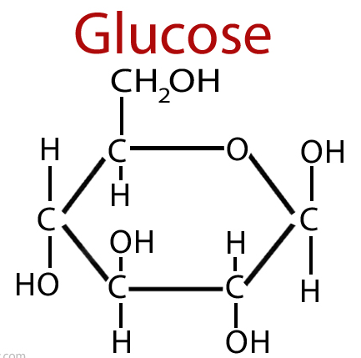
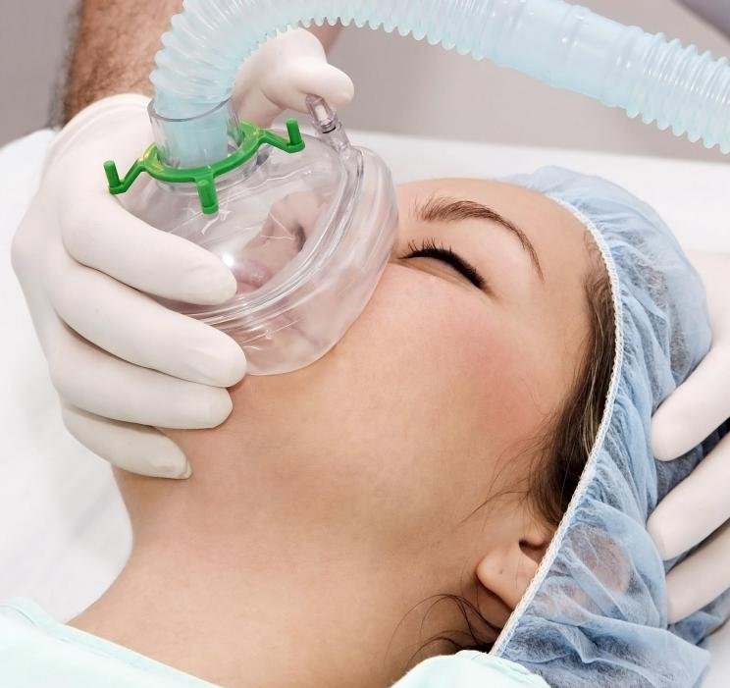
Photosynthesis equation
_{sunlight}
6CO₂ + 6H₂O → C₆H₁₂O₆ + 6O₂
_{sunlight}
carbon dioxide + water → glucose + oxygen

Slide 33
Don’t forget to chunk your notes! These notes have 4 chunks. You will need 4 questions.

Slide 34
Compare and contrast
 | Photosynthesis | Respiration
Function | Uses energy to make food | Makes ATP (energy)
Location of Reaction | Chloroplasts | Mitochondria
Reactants | CO₂ and H₂O | C₆H₁₂O₆ and O₂
Products | C₆H₁₂O₆ and O₂ | CO₂ and H₂O
Chemical Equation | 6CO₂ + 6H₂O → C₆H₁₂O₆ + 60₂ | C₆H₁₂O₆ + 60₂ → 6CO₂+ 6H₂O + ATP
sunlight

Slide 35
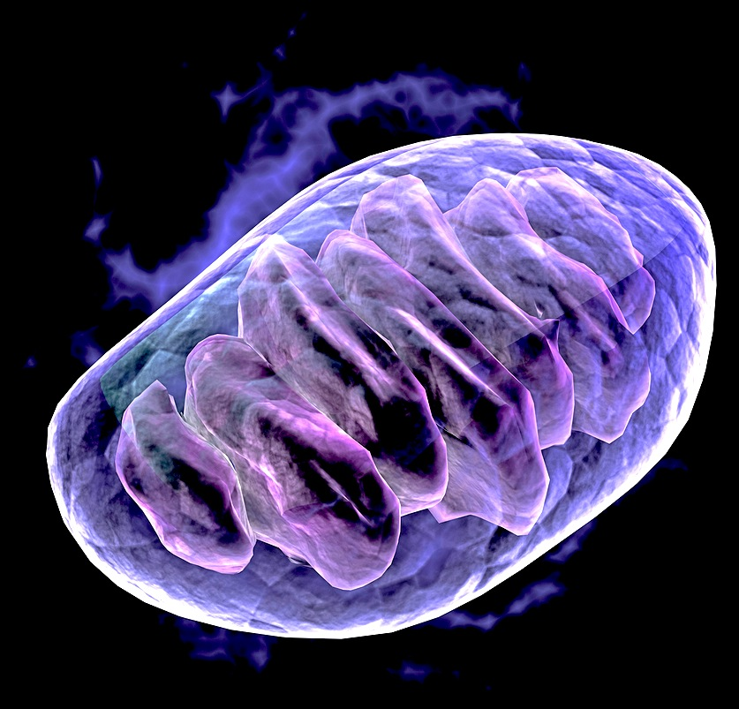
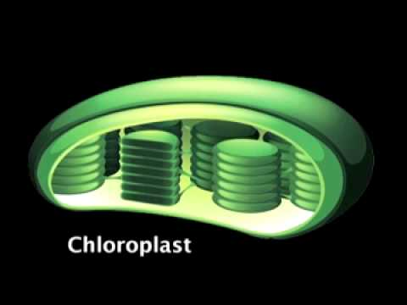
Compare and contrast

