Slide 1
Section 7-1: Photosynthesis
Essential Question:
What do plants use for photosynthesis (reactants)? What do they make (products)?
Learning Target
Use a model to illustrate how photosynthesis transforms light energy into stored chemical energy.

Slide 2
Don’t forget to chunk your notes! These notes have 4 chunks. You will need 4 questions.

Slide 3
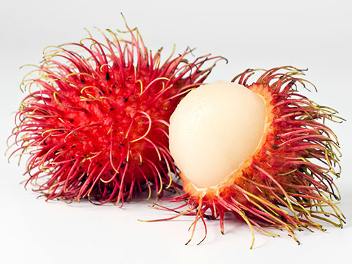
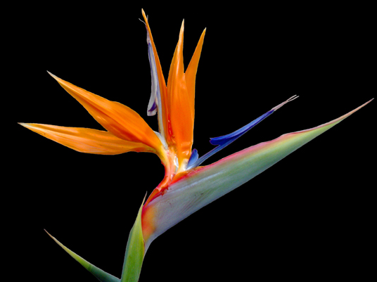
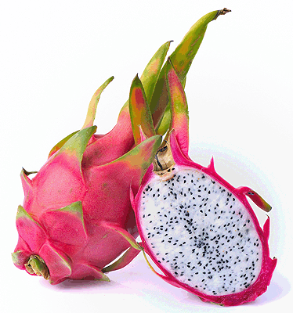
Overview
Autotrophs are organisms that can make their own food (producer)

Slide 4
overview
Autotrophs (producers) “produce” their own food using energy from the sun. _______ are autotrophs.
PLANTS
Notes:
In the blank: plants
Example: Plants! They use sunlight, water and CO2 to make energy and oxygen…
PHOTOSYNTHESIS

Slide 5
overview
Photosynthesis is when plants convert sunlight into sugar
photo = light
synthesis = to make

Slide 6
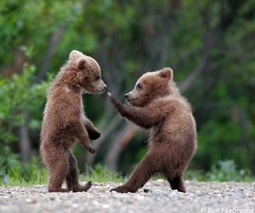
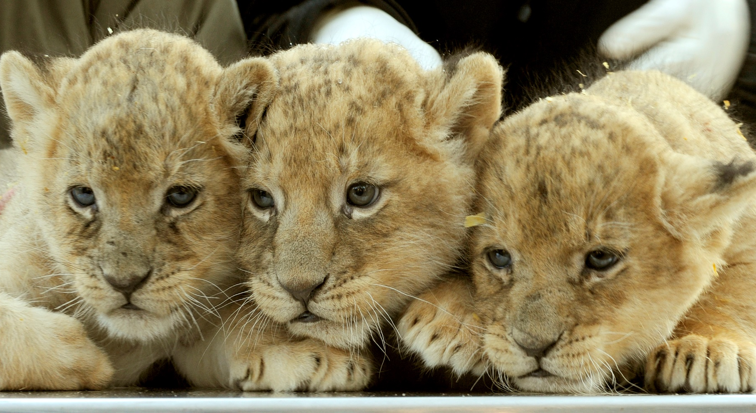
overview
Heterotrophs are organisms that eat other organisms (consumer)

Slide 7
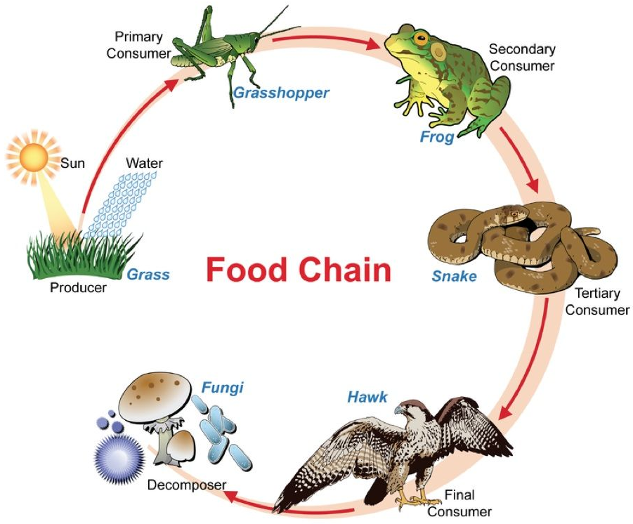
overview
Photosynthesis is important to animals because it produces ________.
Also, without photosynthesis, food chains would collapse.
OXYGEN
Notes:
In the blank: plants
Example: Plants! They use sunlight, water and CO2 to make energy and oxygen…
PHOTOSYNTHESIS

Slide 8
Don’t forget to chunk your notes! These notes have 4 chunks. You will need 4 questions.

Slide 9
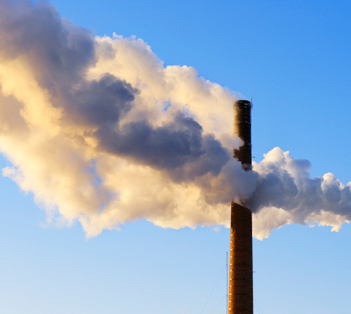
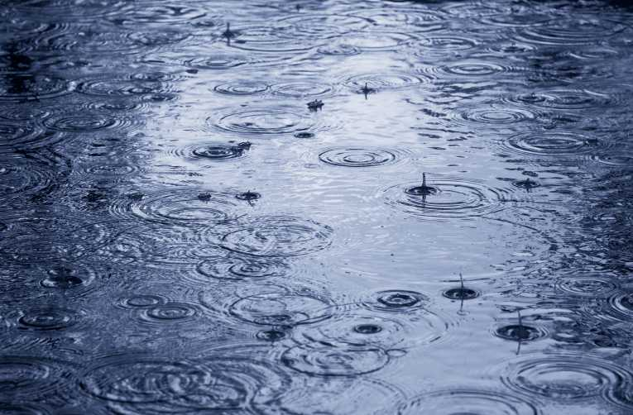
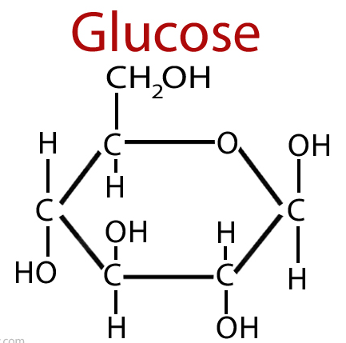
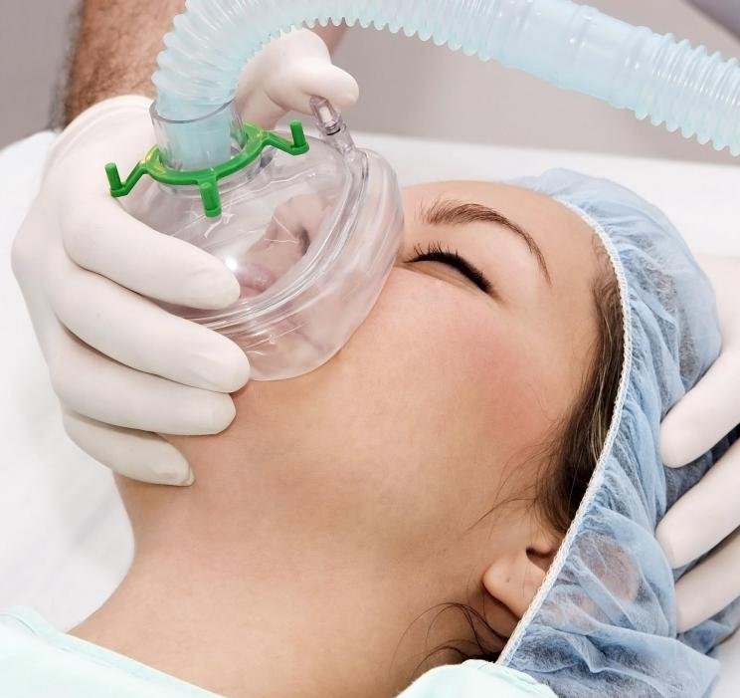
Photosynthesis equation
_{sunlight}
6CO₂ + 6H₂O → C₆H₁₂O₆ + 6O₂
_{sunlight}
carbon dioxide + water → glucose + oxygen

Slide 10
Photosynthesis equation
Uses
(Left side of the arrow = REACTANTS)
Light energy
carbon dioxide (CO₂)
water (H₂O)
Makes
(Right side of the arrow = PRODUCTS)
oxygen (O₂)
glucose (C₆H₁₂O₆)

Slide 11
Photosynthesis equation
Reactant: what is used in a reaction (ingredients)
Ex: Peanut Butter + Jelly + Bread =
Product: what is made in a reaction
Peanut Butter & Jelly Sandwich

Slide 12
_{Reactants Products}
_{light}
6CO₂ + 6H₂O → C₆H₁₂O₆ + 6O₂
_{Reactants Products}
_{light}
carbon dioxide + water → glucose + oxygen

Slide 13
Photosynthesis equation
Photosynthesis is the process that uses energy from SUNLIGHT to transform
________ _____________ and ________
into
___________ and ________________
Carbon
Dioxide
Water
Oxygen
Carbohydrates (glucose)
Notes:
Carbon dioxide, water, oxygen, carbohydrates

Slide 15
Don’t forget to chunk your notes! These notes have 4 chunks. You will need 4 questions.

Slide 16
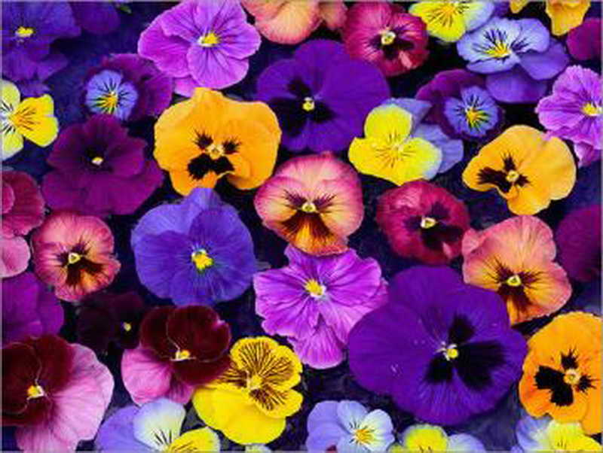
Light & pigments
Plants have pigments

Slide 17
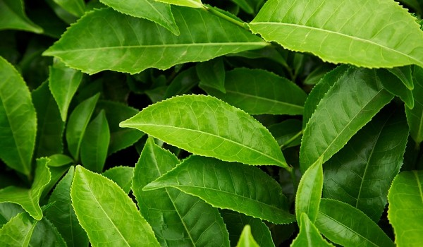
Light & pigments
Pigments are light absorbing molecules that capture the sun’s energy
We can see reflected light.
We cannot see absorbed light.

Slide 18
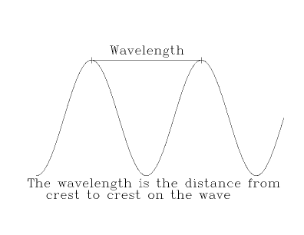
Light & pigments
The sun’s light energy travels in waves
The distance between waves = wavelength
Notes:
green

Slide 19
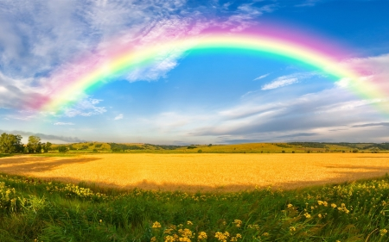
ROY G BIV
The colors of the rainbow are:
Red
Orange
Yellow
Green
Blue
Indigo
Violet
Red has the longest wavelength = Least amount of energy
Violet has the Shortest wavelength = larger amount of energy

Slide 20
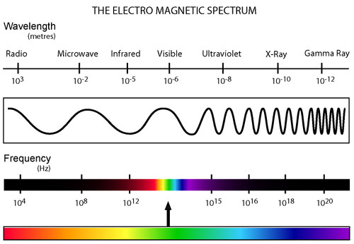
Light & pigments
Different wavelengths of visible light equals different colors.
Notes:
green

Slide 22
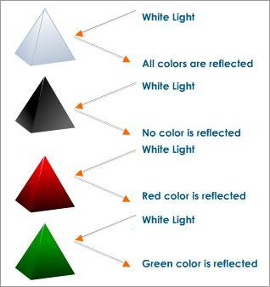
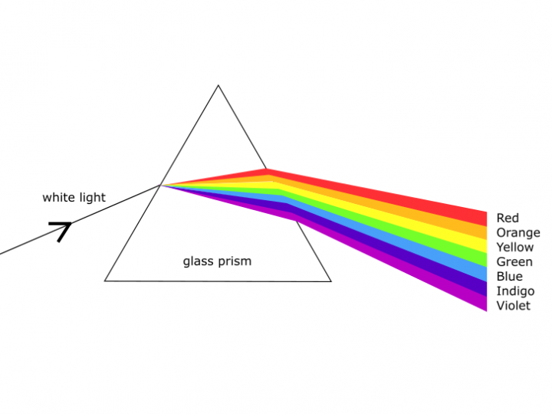
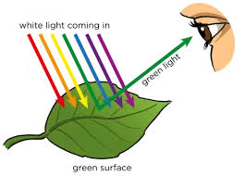
Plants look green because chlorophyll reflects green light.

Slide 23
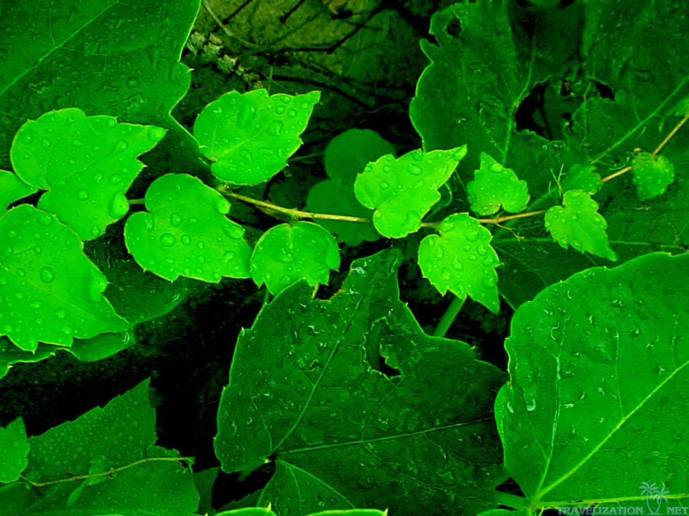
Light & pigments
Chlorophyll is a pigment found in the ________ of __________ .
CHLOROPLASTS
PLANT CELLS
Notes:
plants

Slide 24
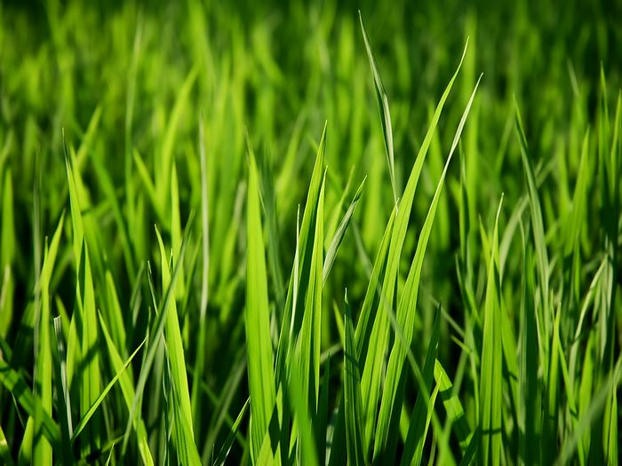
Light & pigments
Chlorophyll makes plants ________ .
GREEN
Notes:
green

Slide 25
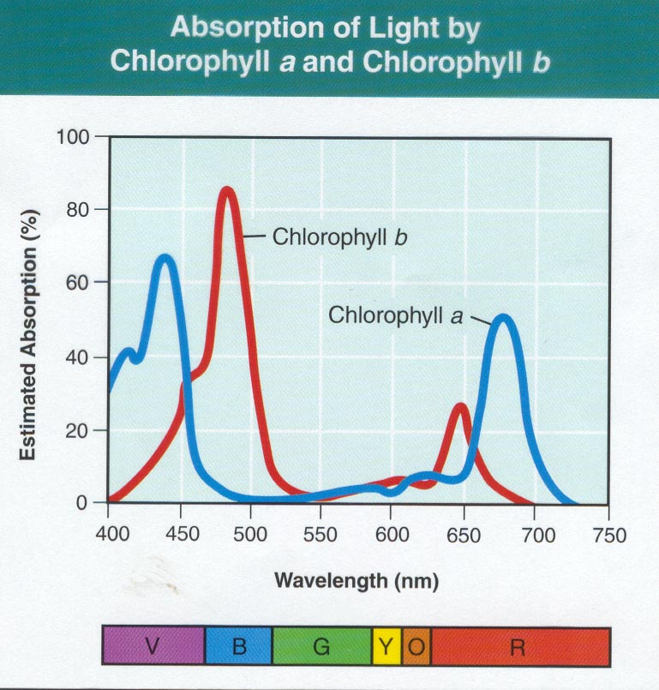
Light & pigments
2 types:
Chlorophyll a
Chlorophyll b

Slide 26
Light & pigments
Chlorophyll pigments absorb red and blue light well.
They do not absorb _______ light very well.
GREEN
Notes:
Pigments Include:
chlorophyll a
chlorophyll b
absorbs well in red and blue but poorly in green
plants also have red , yellow and orange pigments that absorb other colors
energy is transferred to electrons in pigments when they absorb sunlight

Slide 27
Is the color green being reflected or absorbed by plants?
Notes:
reflected

Slide 29
Don’t forget to chunk your notes! These notes have 4 chunks. You will need 4 questions.

Slide 30
Inside a chloroplast
Photosynthesis takes place in the chloroplasts of plants.
Chloroplasts are the organelles used for photosynthesis.
Chloroplasts are only found in plant cells.

Slide 31
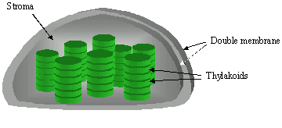
Inside a chloroplast
Chloroplasts have TWO parts:
Thylakoids are saclike membranes found in chloroplasts
A group of thylakoids = Grana
Pigments inside thylakoids capture sunlight during LIGHT-DEPENDENT REACTIONS (LDR)

Slide 32
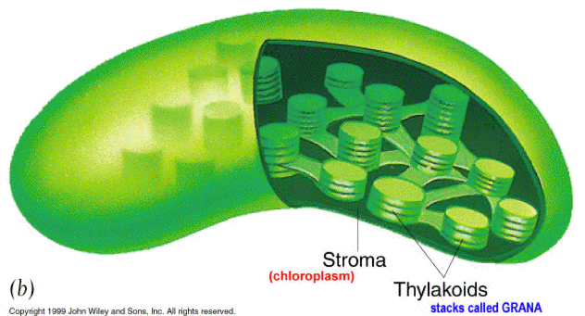
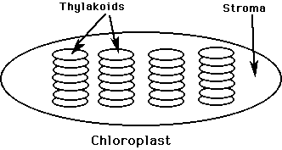
Inside a chloroplast
Chloroplasts have TWO parts:
Stroma is the space surrounding the thylakoids and where the CALVIN CYCLE (LIR) takes place.

Slide 33
The chloroplast

Slide 34
Don’t forget to chunk your notes! These notes have 4 chunks. You will need 4 questions.

Slide 35
www.Biophamily.weebly.com
Notes:
reflected

